Slide 1
Number plate detector
Created by
Lengyel Dániel

Slide 2

Content
Assignment of tasks
Project Manager Tools
Structure of the code I.
Structure of the code II.
Presentation of the code

Slide 3

Assignment of tasks
Komjáti Gábor – camera drawing
Potyondi Zsombor – Document scanner
Lengyel Dániel – Number plate detector

Slide 4
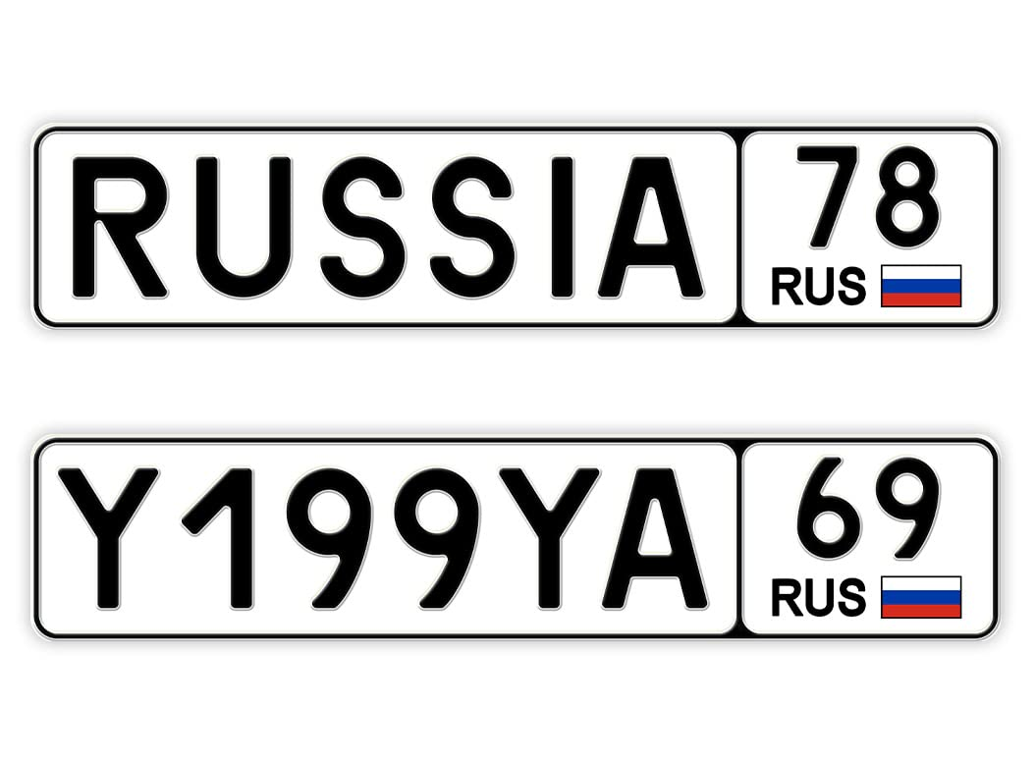

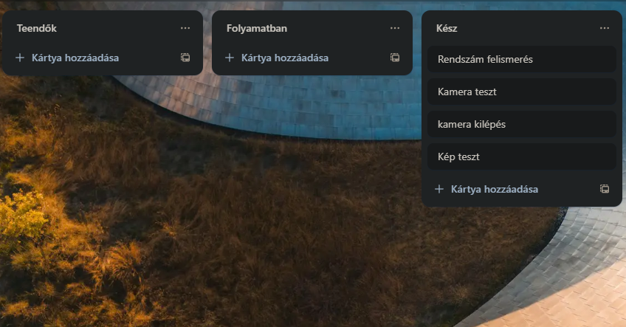


Project Manager Tools
Project Manager tool: trello
Programming tool: Pycharm
Programming language: python
Source: Video
Tools used: camera, images
Project Uploaded from: Github

Slide 5
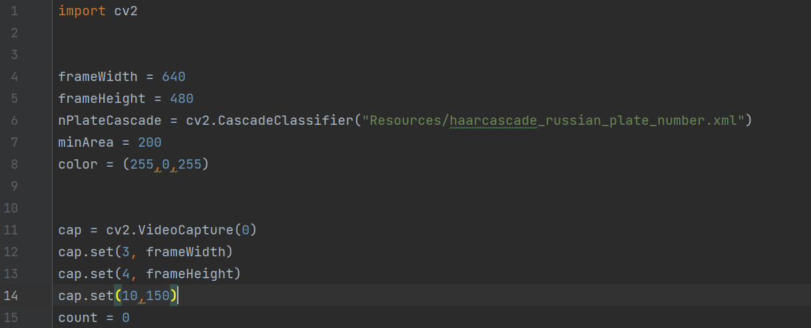
Structure of the code I.
Import
Preparing the camera
Loading .xml

Slide 6
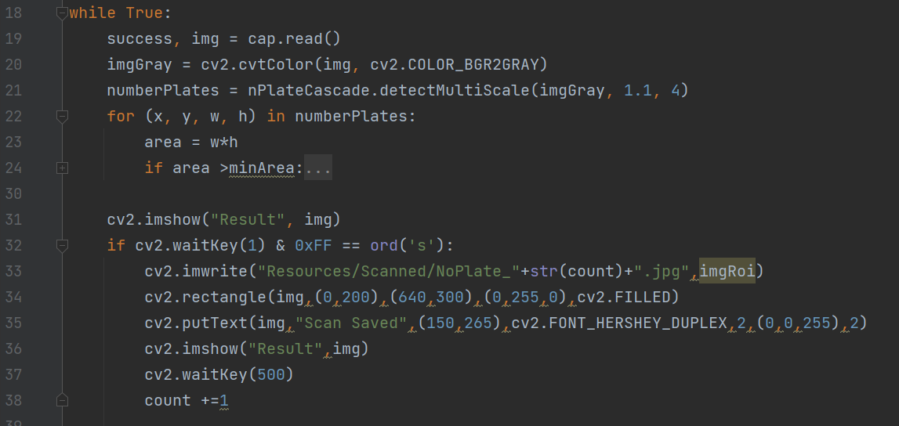
Structure of the code II.
Scan video
License plate search
Save image

Slide 7
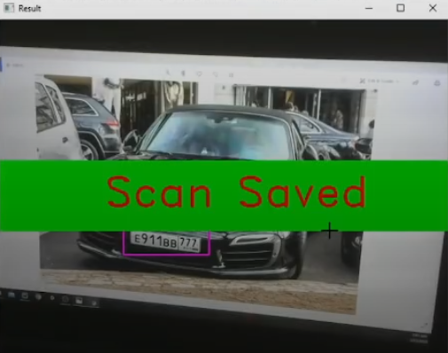
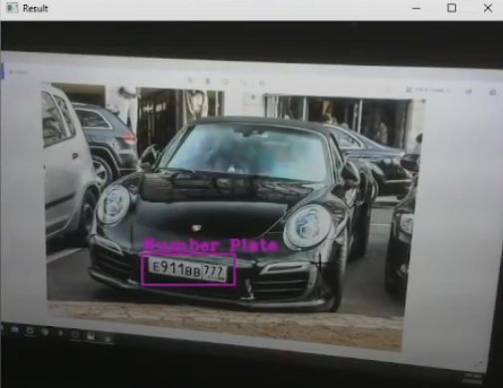
Presentation of the code
The program can:
Recognise from images
Recognize from camera
Save

Slide 8
Thank you for your attention

